Slide 1
Understanding Harmony in Nature Interconnectedness, Self-regulation and Mutual Fulfillment among the Four Orders of Nature

Slide 2
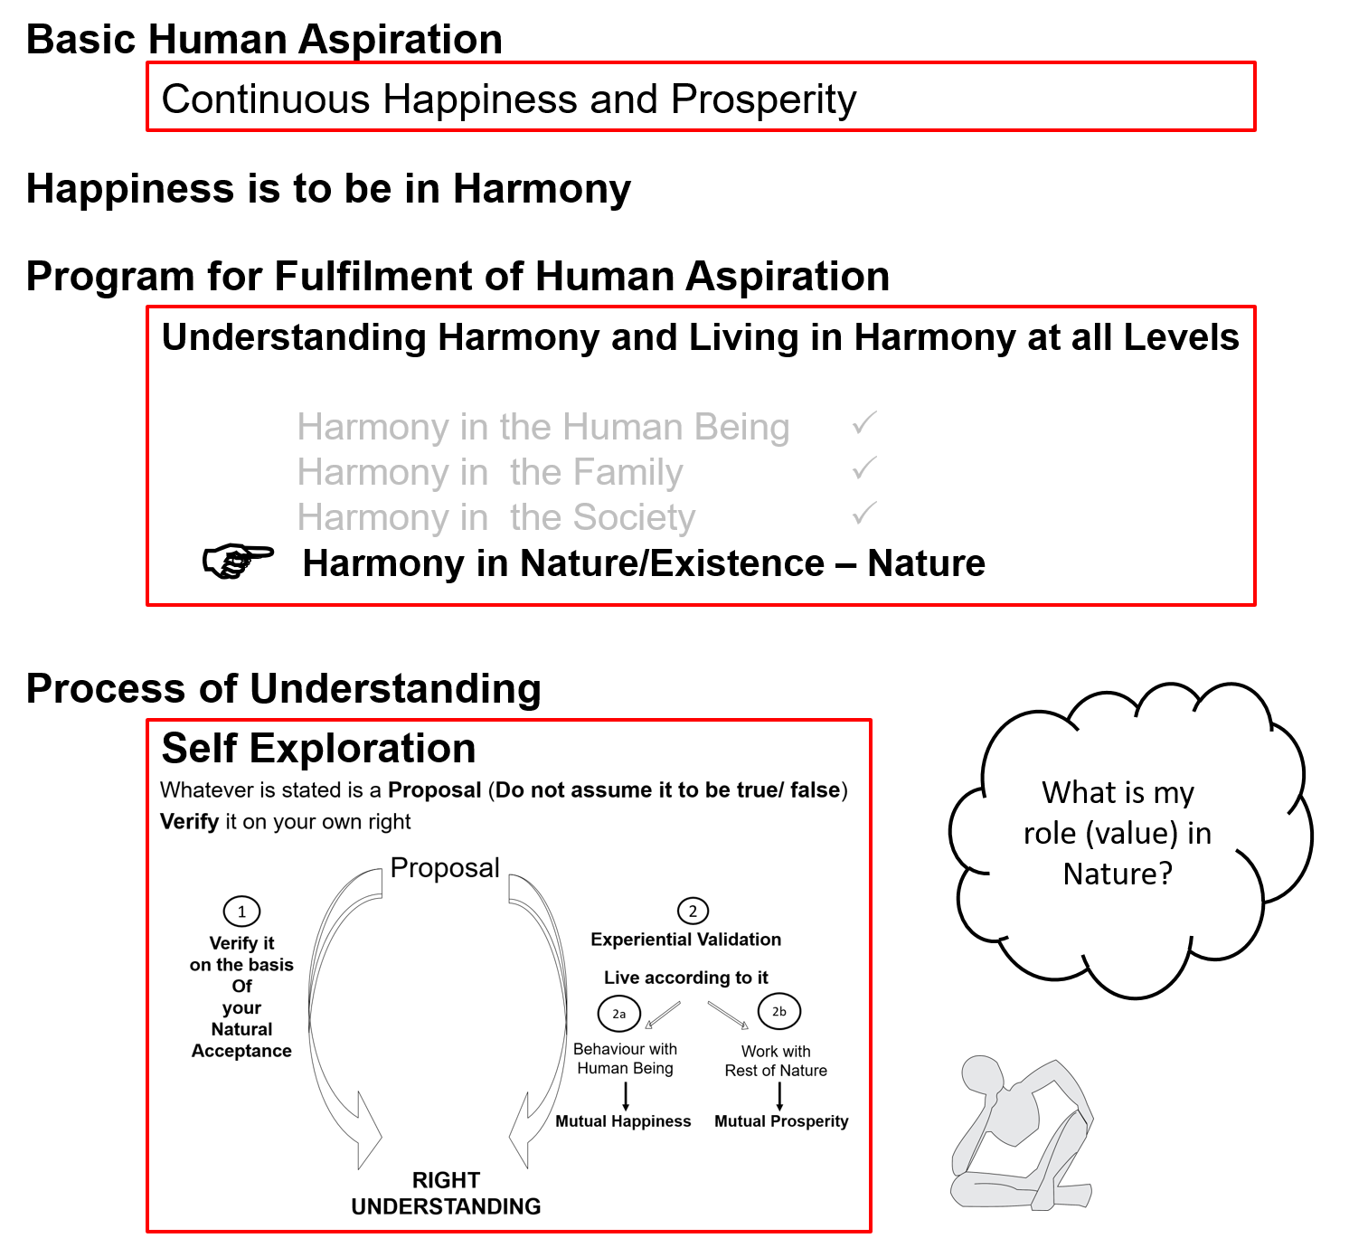

Slide 3
Introduction
So far we have explored our Natural Acceptance
Our Natural Acceptance is for living in Harmony – as an Individual, as a Family, as a Society…
Is there provision in Nature/Existence for living in accordance with our Natural Acceptance?
Is it possible to live in harmony as an Individual, as a Family, as a Society…?
Is co-existence, mutual fulfillment inherent in Nature?
Or
Is the design of nature/existence by way of opposition, struggle, survival of the fittest…?
We will explore the underlying design of Nature/Existence with these questions…

Slide 4
Nature = Collection of Units
Air
Water Trees
Soil
Animal body
Birds Animals Human body
Self(I)
Human Beings
Earth Sun
Moon Metals

Slide 5
Nature = Collection of Units = 4 Orders
All units can be categorised into 4 orders
Bio Order
Plants, Trees
Physical Order
Soil, Metal
Animal Order
Animals, Birds
Human Order
Human Being

Slide 6
Relationship of Mutual Fulfillment
Between Physical Order and Bio Order
Interconnected, Interdependent
Mutual Fulfillment
Cyclic
Every unit is enriched
Mutual Fulfillment = Relatedness + Fulfillment
Bio Order
Plants, Trees
Physical Order
Soil, Metal

Slide 7
Relationship of Mutual Fulfillment
Between Physical Order, Bio Order and Animal Order
Interconnected, Interdependent
Mutual Fulfillment
Cyclic
Every unit is enriched
Bio Order
Plants, Trees
Physical Order
Soil, Metal
Animal Order
Animals, Birds

Slide 8
Relationship of Mutual Fulfillment
Physical Order, Bio Order and Animal Order are enriching for Human Order, but Human Order (without right understanding) is not fulfilling for any of the 4 orders
Human beings have
natural acceptance
to be mutually fulfilling
Once human beings understand,
they can be fulfilling for all four orders
Bio Order
Plants, Trees
Physical Order
Soil, Metal
Animal Order
Animals, Birds
√
?
√
?
√
?
Human Order
Human Being

Slide 9
Present-day Problems are largely due to Lack of Understanding
Resource Depletion – The resource is used at a rate which is faster than the rate at which it is produced in nature
Pollution – The product is such that
It does not return to the cycle in nature or
It is produced at a rate that is faster than the rate at which it can return to the cycle in nature

Slide 10
Details of the Four Orders
ORDERS | UNITS | ACTIVITY | INNATENESS (Self-organization) | INHERITANCE
Physical | Soil, Metal | Formation-Deformation | Existence | Constitution based
Bio | Plants, Trees | "-“ + Respiration | " + Growth | Seed based
Animal | Animals, Birds | "-“, " in Body Selecting-Tasting in I | ", " in Body Will to live in I | Breed based
Human | Human Beings | "-“, " in Body Imaging, Analysing-Comparing, Selecting-Tasting in I Potential for Understanding in I | ", " in Body Will to live with continuous happiness in I Right Feeling Right Understanding | Education-Sanskar based
Inheritance: How conduct is decided, maintained generation after generation

Slide 11
Role of Education-Sanskar
ORDERS | UNITS | ACTIVITY | INNATENESS (Self-organization) | NATURAL CHARACTERISTIC (Participation) | INHERITANCE
Physical | Soil, Metal | Formation-Deformation | Existence | Composition-Decomposition | Constitution based
Pranic | Plants, Trees | "-“ + Respiration | " + Growth | " + Nurture-Worsen | Seed based
Animal | Animals, Birds | "-“, " in Body Selecting/Tasting in I | ", " in Body Will to live in I | ", " in body Cruelty, Non-cruelty in I | Breed based
Human | Human Beings | "-“, " in Body Imaging, Analysing, Selecting/Tasting in I Potential for Understanding in I | ", " in Body Will to live with continuous happiness in I Right Feeling & Thought Knowledge | ", " in body Perseverance, Bravity, Generosity in I | Education-Sanskar based
Next Generation
Human Tradition
Human Education-sanskar

Slide 12
Participation of Human Being in Entire Nature
Preservation (enrichment, protection and right utilization) of nature
Prosperity, fulfilment of human needs (in a manner that preserves nature)
i.e. by:
Protecting its innateness
Protecting and enriching its inheritance
Making right utilization of nature, in line with its activity
(or at least not violating their innateness, inheritance or activity)

Slide 13
Participation of Human Being in Entire Nature
Physical order: Soil, water, air…
Protect its innateness (existence)
(eg. Protect constitution of Earth)
Bio order: Plants, trees…
Protect and nurture its innateness (existence and growth)
(eg. Ploughing farmland)
Ensure its inheritance (seed)
(eg. Maintain seed of rice)
Animal order: Animals and birds
Protect its innateness (will to live)
(eg. Adequate forest, food, shelter)
Ensure its inheritance (breed)
(eg. Maintain breed of cow)
Human order: Human being
Protect its innateness (will to live with continuous happiness)
(eg. Provide societal systems for facilitating and living with right understanding)
Ensure its inheritance (education-sanskar)
(eg. Ensure human education-sanskar)

Slide 14
Participation of Human Being in Entire Nature
To understand the inherent harmony in nature and to live accordingly, i.e.
To facilitate a conducive environment for the activity (at least not violate it) of all orders
To facilitate the innateness (or at least not violate it) of all orders
To facilitate the inheritance (or at least not violate it) of all orders
Order | Human Participation for Mutual Fulfillment
Physical Order | Facilitate its existence by ensuring conducive environment and maintaining / ensuring its constitution (eg. constitution of earth)
Bio Order | Facilitate its growth by ensuring conducive environment and maintaining / ensuring its seed (e.g. seed of rice)
Animal Order | Facilitate care of the body by ensuring physical facility, environment for existence & growth of body. To ensure its will to live Maintaining / ensuring its breed (eg. breed of cow)
Human Order | Facilitate care of the body by ensuring physical facility, environment for existence & growth of body Facilitate its will to live with continuous happiness by ensuring human education-sanskar, participating in developing / maintaining undivided society & universal human order

Slide 15
Natural Characteristic
Tendency of Human Living with Animal Consciousness
Wretchedness The feeling I can not take care of my body,
hence I resort to being dependent on the other
Cunningness The feeling I can not take care of my body,
hence I resort to beguiling the other
Cruelty The feeling I can not take care of my body,
hence I resort to forcefulness & violence
Natural Characteristic of Human Living with Human Consciousness
Perseverence Being assured that the all-encompassing solution is to
understand & to live in harmony at all 4 levels, I live
with this commitment without any perturbation
Bravery The commitment to help the other develop right
understanding & to live accordingly
Generosity Readiness to invest oneself, one's body & physical facility
to help the other develop right understanding & to live
accordingly

Slide 16
Harmony in Nature
Nature is organised in such a manner that the physical facility required for any order is available in abundance*
Dependence of any order is on all previous orders
e.g. Bio order is dependent on physical order
e.g. Human order needs the most conducive
environment. Human order depends on
animal order, bio order as well as
physical order
Quantity of units
Physical >> Bio >> Animal >> Human
*Need of physical facility is limited
Availability is also limited but in
A quantity much larger than need
Animal Order
Bio Order
Physical Order
Human Order

Slide 17
Harmony in Nature
All orders have definite conduct except human order without right understanding
In human being, the body has definite conduct
The Self (I) operating on assuming without knowing is the source of indefiniteness, problem
The solution is to ensure knowing
The natural acceptance is to know,
to be in harmony
For this,
human education-sanskar
Is required
Human Order
Animal Order
Bio Order
Physical Order

Slide 18
Sum Up
Physical order – soil, metals etc.
Bio order – trees, plants etc.
Animal order – animals, birds etc.
Human order – human beings
There is a relationship of mutual fulfilment (harmony) amongst these 4 orders. The first 3 orders are mutually fulfilling for each other. They are fulfilling for human being also. It is naturally acceptable to human beings to be fulfilling for all the orders
The role of human being is to realize this mutual fulfilment – For this, all that human beings need to do is:
To understand that mutual fulfilment (harmony) is inherent in nature – we do not have to create it
To live accordingly – then the mutual fulfilment amongst the 4 orders will be realised
and there is provision in nature for living with mutual fulfilment (harmony)
Nature = Collection of Units
= 4 Orders
Relationship of mutual fulfilment (harmony)

Slide 19
Realizing Existence as Co-existence at All Levels The Holistic Perception of Harmony in Existence

Slide 20
Harmony in Existence vfLrRo esa O;oLFkk
Existence = Exist + Essence
Whatever ↓ ↓
Exists is/to be harmony (mutual fulfillment)
Existence = Co- Existence = Units submerged in Space

Slide 21
Harmony in Existence
Existence =
Units Submerged in Space Ever Present
Limited in Size Unlimited
(All Pervading)
Activity No Activity
Units are:
1. Energised in Space
2. Self organized in Space
3. Recognises it's relationship,
Fulfills its relationship with every other Unit in Space
CO-EXISTENCE

Slide 22
3.1.2. Knowledge of Existence
Existence
Ever Present
Units Submerged in Space
Limited in Size Unlimited All Pervading
Activity, Active No Activity
Material Consciousness
Recognizing, Knowing, Assuming,
Fulfilling Recognizing, Fulfilling
Temporary Continuous,Unbounded in Time & Space

Slide 23
Sum Up
Existence is in the form of co-existence. It is ever present
(Existence = Co- Existence = Units submerged in Space)
Every unit in existence is related with every other unit in existence in a mutually fulfilling manner
Synergy is intrinsic to existence, harmony is inherent in existence – we do not have to create it, we do not have to construct it
The role of Human Being is to realize this co-existence, this harmony, this order in existence – For this, all that human beings need to do is:
To understand the inherent harmony, the co-existence in existence
To live accordingly – to live with the feeling of harmony or co-existence (and there is every provision in existence for living in co-existence)

